Slide 1
QUIZ APPLICATION
Group 8
Bheemavarapu kavya Chowdary
Nuthakki Bhargav
Chakkala Sai Pujith

Slide 2
INDEX
SET UP
ARCHITECTURE
SEQUENCE DIAGRAM
LOGIN
ADMIN
USERS
CONCLUSION

Slide 3


SET UP
Technologies : MERN STACK
Front-end: React Js
Middleware: Express Js
Database: MongoDB
Platform: Node Js
Environment: visual studio code
Testing: Chai , sinon, mocha,enzyme

Slide 4
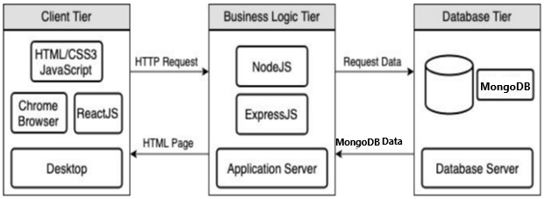
ARCHITECTURE
CLIENT-SERVER ARCHITECTURE

Slide 5
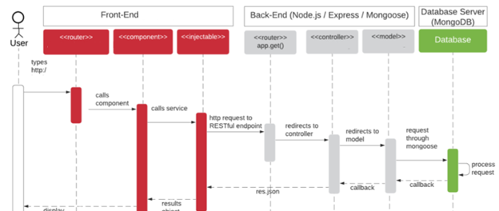
SEQUENCE DIAGRAM

Slide 6
DESIGN PATTERN
SINGLETON DESIGN PATTERN
The singleton in react is a bit different from that in JS. Classically, if an instance already exists, it will simply return a reference to that object. In react, however, it should not render(or create element) rather than returning a reference to the object because the render() method has encapsulated the creation method React.createElement().

Slide 7
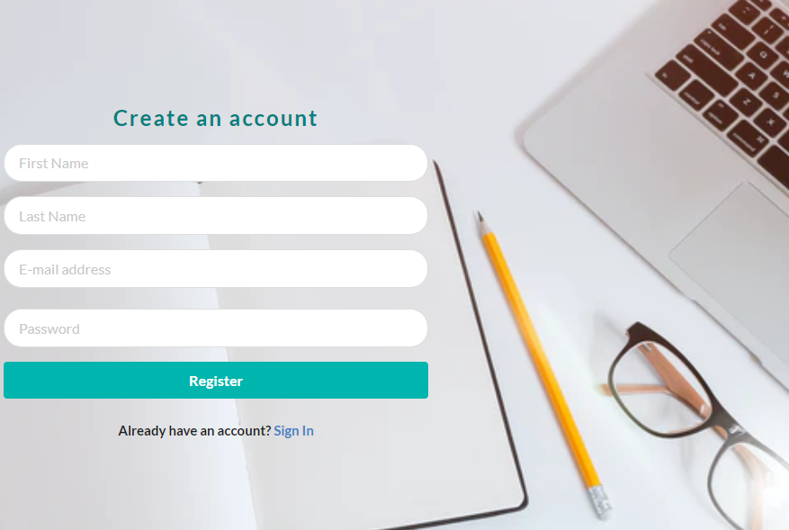
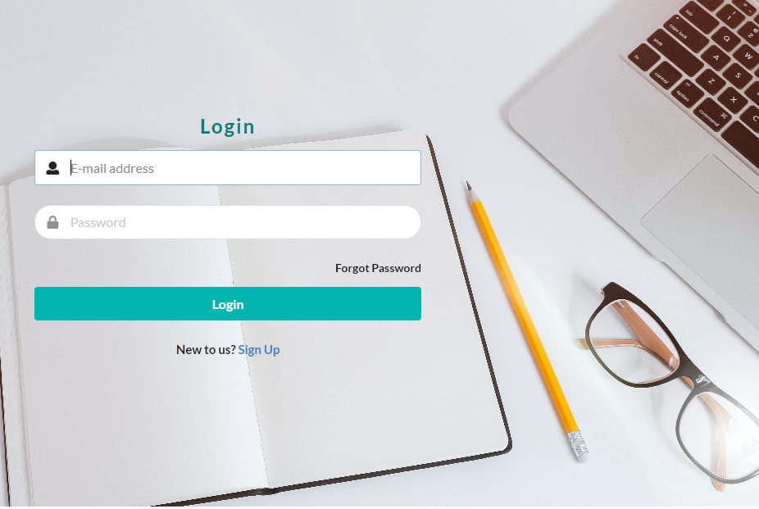
LOGIN

Slide 8
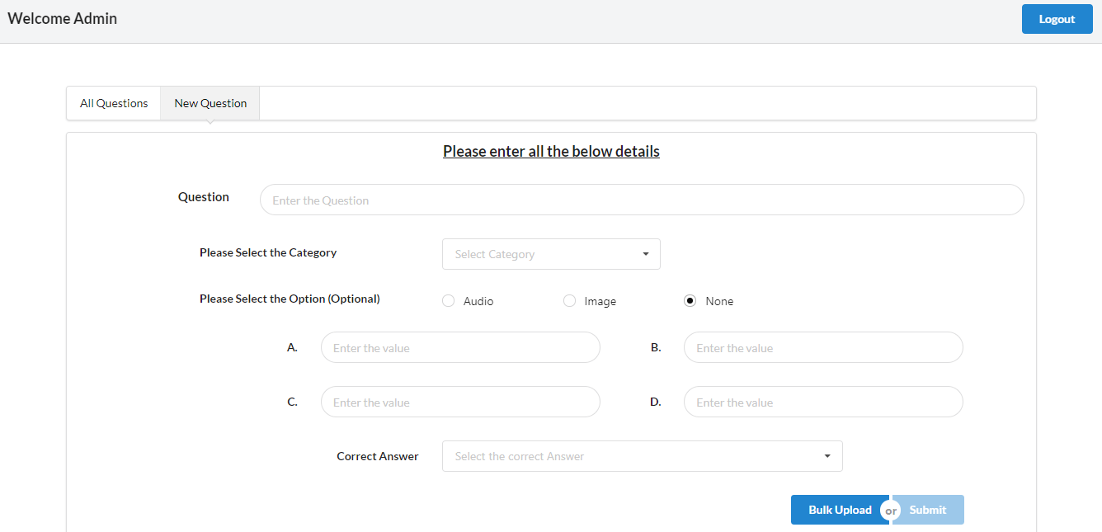
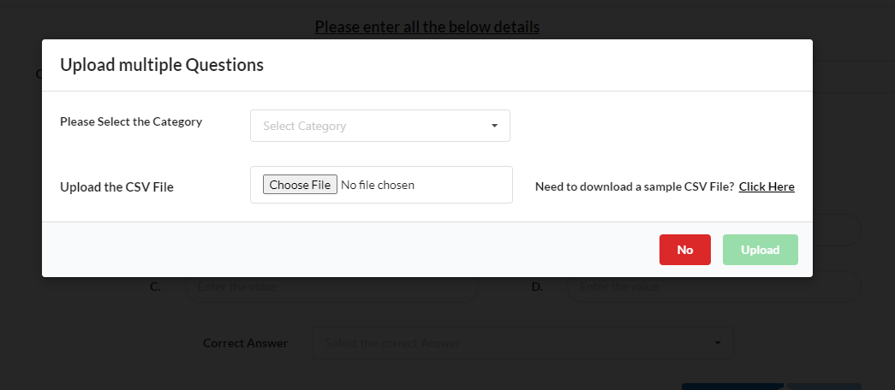
ADMIN

Slide 9
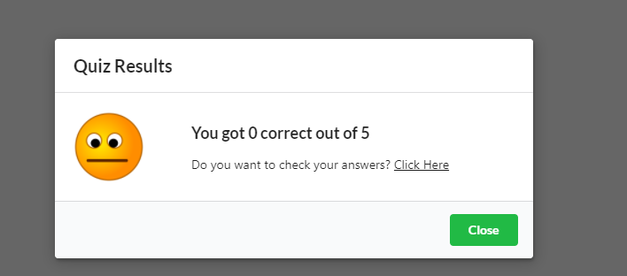
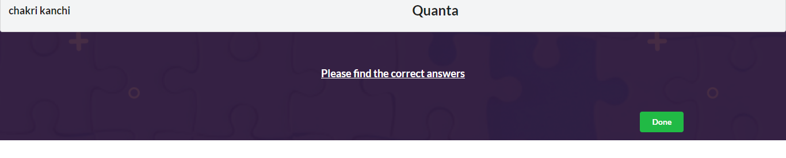
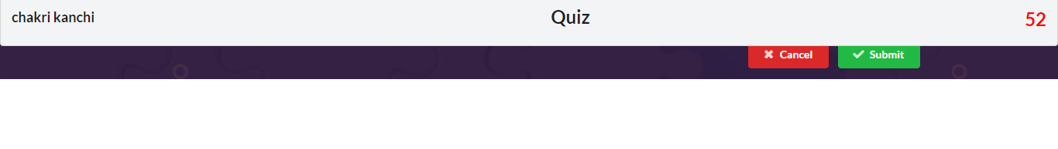
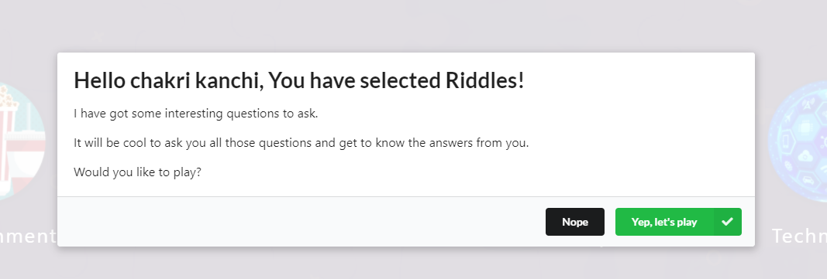
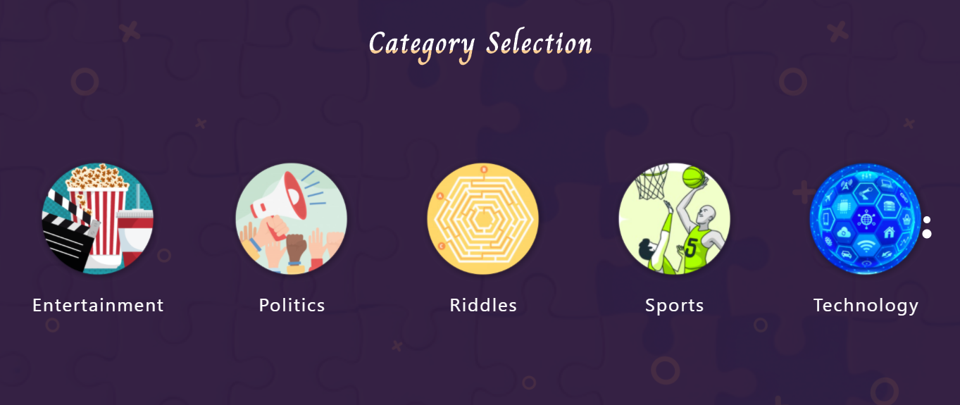
USER

Slide 10
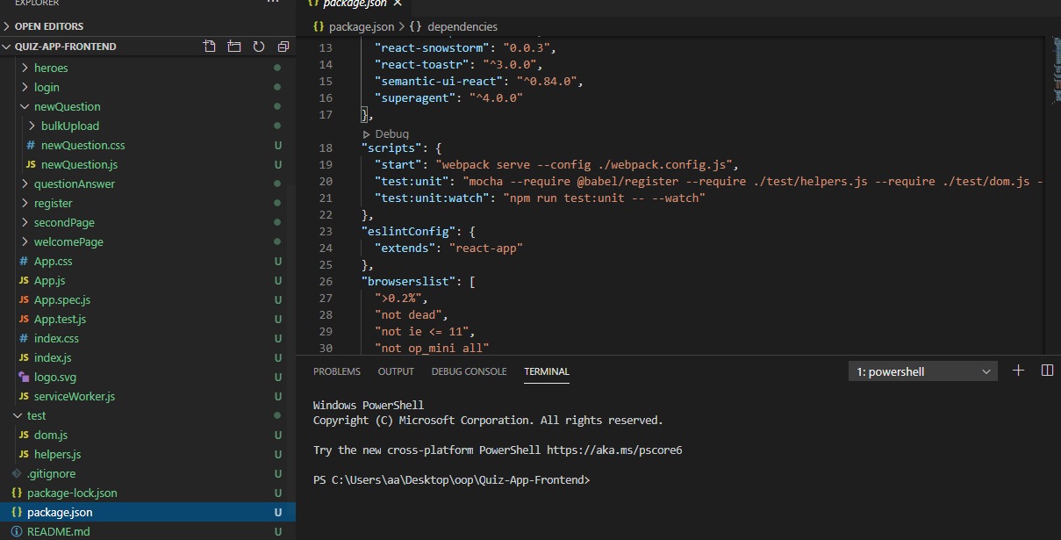
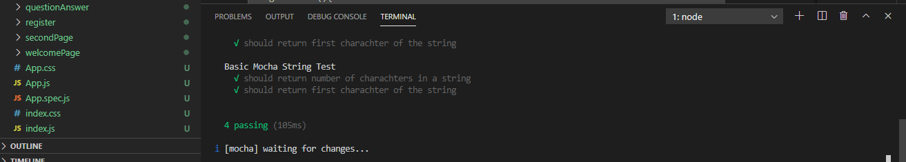
TESTING
Chai , sinon, mocha,enzyme

Slide 11
CONCLISION
This application uses most of the compatible technologies and working model. A lot of features can be added to this application and can be provided as a updated version.
Group chat
Messaging bot
Notifications
Creating quizzes and making a room

Slide 12

THANK YOU

